Slide 1
Typography
h1. Heading 1
h2. Heading 2
h3. Heading 3
h4. Heading 4
h5. Heading 5
h6. Heading 6
Nullam quis risus eget urna mollis ornare vel eu leo. Cum sociis natoque penatibus et magnis dis parturient montes, nascetur ridiculus mus. Nullam id dolor id nibh ultricies vehicula.
Body Copy
Vivamus sagittis lacus vel augue laoreet rutrum faucibus dolor auctor. Duis mollis, est non commodo luctus.
Lead Copy
This line of text is meant to be treated as fine print.
Muted text. Muted text. Muted text. Muted text. Muted text.
Warning text. Warning text. Warning text. Warning text. Warning text.
Error text. Error text. Error text. Error text. Error text.
Info text. Info text. Info text. Info text. Info text.
Success text. Success text. Success text. Success text.
<code>Example code</code>

Slide 2


Virtual Private Networks (VPN)
And
Tor Network (DarkNet)
Virtual Private Networks
Learn more »
Austin Vern Songer
https://www.linkedin.com/in/austinvernsonger
http://austinvernsonger.github.io/
http://austinvernsonger.com
Close
Save

Slide 3
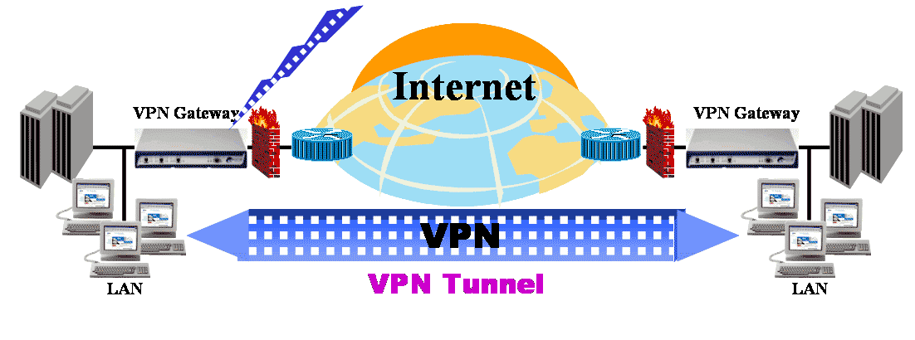

Home
Search
Virtual Private Network
is a type of private network that uses public telecommunication, such as the Internet, instead of leased lines to communicate.
Must emulate a point-to-point link
Must emulate a private link

Slide 4
QUESTION:
What Does VPN Stand For?
A. Virtual Public Network
B. Virtual Private Network
C. Virtual Protocol Network
D. Virtual Perimeter Network

Slide 5
Home
Search
Critical Functions
Data Encryption
Data Origin Authentication
Secure Generation and timely refresh of keys needed for encryption and authentication
Protection against Replay of Packets and Address Spoofing

Slide 6
Home
Search
VPN’s are usually used for:
Intranets
Remote Access
Extranets

Slide 7
Home
Search
What Is IPSec and How Does It Work?
IPSec is an Internet Engineering Task Force (IETF) standard suite of protocols that provides data authentication, integrity, and confidentiality as data is transferred between communication points across IP networks

Slide 8
Home
Search
IPSec Security Features
• Authentication: Verifies that the packet received is actually from the claimed sender.
• Integrity: Ensures that the contents of the packet did not change in transit.
• Confidentiality: Conceals the message content through encryption.

Slide 9
Home
Search
IPSec Components
Encapsulating Security Payload (ESP): Provides confidentiality, authentication, and integrity.
• Authentication Header (AH): Provides authentication and integrity.
• Internet Key Exchange (IKE): Provides key management and Security Association (SA) management.

Slide 10
Home
Search
Encapsulating Security Payload (ESP)
ESP provides authentication, integrity, and confidentiality, which protect against data tampering and, most importantly, provide message content protection.

Slide 11
Home
Search
Authentication Header (AH)
AH provides authentication and integrity, which protect against data tampering, using the same algorithms as ESP. AH also provides optional anti-replay protection, which protects against unauthorized retransmission of packets. The authentication header is inserted into the packet between the IP header and any subsequent packet contents. The payload is not touched.

Slide 12
Home
Search
Security Association
IPSec introduces the concept of the Security Association (SA). An SA is a logical connection between two devices transferring data. An SA provides data protection for unidirectional traffic by using the defined IPSec protocols. An IPSec tunnel typically consists of two unidirectional SAs, which together provide a protected, full-duplex data channel.

Slide 13
Home
Search
The Layer Two Forwarding (L2F) Protocol
L2F is a Cisco proprietary protocol that is designed to allow the tunneling of PPP (or Serial Line Interface Protocol [SLIP]) frames between a NAS and a VPN gateway device located at a central site. Remote access users connect to the NAS, and the PPP frames from the remote access user are then tunneled over the intervening network to the VPN (home) gateway

Slide 14
Home
Search
Point-to-Point Tunneling Protocol (PPTP)
IPSec introduces the concept of the Security Association (SA). An SA is a PPTP is a protocol that was developed by a consortium of vendors, including Microsoft, 3Com, and Ascend Communications. Like L2F, PPTP allows the tunneling of remote access client PPP frames between a NAS and a VPN gateway/concentrator. PPTP also allows a tunnel to be set up directly from a remote access client to a VPN gateway/concentrator.

Slide 15
Home
Search
Layer 2 Tunneling Protocol versions 2 and 3 (L2TPv2/L2TPv3)
L2TP is an Internet Engineering Task Force (IETF) standard and combines the best features of L2F and PPTP. In a remote access environment, L2TP allows either tunneling of remote access client PPP frames via a NAS to a VPN gateway/concentrator or tunneling of PPP frames directly from the remote access client to the VPN gateway/ concentrator.

Slide 16
Home
Search
Secure Sockets Layer (SSL)
SSL is a security protocol that was originally developed by Netscape Communications (SSL versions 1, 2, and 3), and it provides secure remote access for mobile users or home users. Functionality may be limited (when compared with L2F, PPTP, L2TPv2, or IPsec) if clientless SSL remote access VPNs are deployed.

Slide 17
Home
Search
Security Association
IPSec introduces the concept of the Security Association (SA). An SA is a logical connection between two devices transferring data. An SA provides data protection for unidirectional traffic by using the defined IPSec protocols. An IPSec tunnel typically consists of two unidirectional SAs, which together provide a protected, full-duplex data channel.

Slide 18
Home
Search
Routing for VPN

Slide 19
Home
Search
VPV Server Behind A FireWall

Slide 20
Home
Search
VPN Server In Front of A FireWall

Slide 21
Home
Search
Alert!

Slide 22
Home
Search
Alert!

Slide 23
Home
Search

Slide 24
Home
Search

Slide 25
Home
Search

Slide 26
Home
Search

Slide 27
Lists, Tooltips, Labels, Alerts, Popovers
Unordered List Item 1
Sub Item 1.1
Sub Item 1.2
Unordered List Item 2
Unordered List Item 3
Tooltip
Tooltip
Label
Inverse
Labels
Tooltip
Tooltip
Ordered List Item 1
Sub Item 1.1
Sub Item 1.2
Ordered List Item 2
Ordered List Item 3
Tooltip
Tooltip
Tooltip
Tooltip
Alert! This is an alert. This is an alert. This is an alert.
Alert!
This is an alert. This is an alert. Nulla vitae elit libero, a pharetra augue. Praesent commodo cursus magna, vel scelerisque nisl consectetur et.
Popover top
Sed posuere consectetur est at lobortis. Aenean eu leo quam. Pellentesque ornare sem lacinia quam venenatis vestibulum.
Popover bottom
Sed posuere consectetur est at lobortis. Aenean eu leo quam. Pellentesque ornare sem lacinia quam venenatis vestibulum.
Popover right
Sed posuere consectetur est at lobortis. Aenean eu leo quam. Pellentesque ornare sem lacinia quam venenatis vestibulum.
Popover left
Sed posuere consectetur est at lobortis. Aenean eu leo quam. Pellentesque ornare sem lacinia quam venenatis vestibulum.

Slide 28
Lists, Tooltips, Labels, Alerts, Popovers
Unordered List Item 1
Sub Item 1.1
Sub Item 1.2
Unordered List Item 2
Unordered List Item 3
Tooltip
Tooltip
Label
Inverse
Labels
Tooltip
Tooltip
Ordered List Item 1
Sub Item 1.1
Sub Item 1.2
Ordered List Item 2
Ordered List Item 3
Tooltip
Tooltip
Tooltip
Tooltip
Alert! This is an alert. This is an alert. This is an alert.
Alert!
This is an alert. This is an alert. Nulla vitae elit libero, a pharetra augue. Praesent commodo cursus magna, vel scelerisque nisl consectetur et.
Popover top
Sed posuere consectetur est at lobortis. Aenean eu leo quam. Pellentesque ornare sem lacinia quam venenatis vestibulum.
Popover bottom
Sed posuere consectetur est at lobortis. Aenean eu leo quam. Pellentesque ornare sem lacinia quam venenatis vestibulum.
Popover right
Sed posuere consectetur est at lobortis. Aenean eu leo quam. Pellentesque ornare sem lacinia quam venenatis vestibulum.
Popover left
Sed posuere consectetur est at lobortis. Aenean eu leo quam. Pellentesque ornare sem lacinia quam venenatis vestibulum.

Slide 29
Buttons, Form Controls
Large button
Large button
Large button
Text input
Default button
Default button
Default button
Textarea
Small button
Small button
Small button
Mini button
Mini button
Mini button
Checkbox
Checkbox
Left Middle Right
Button Group
Radio Button
Radio Button
Large button
Large action
Drop-Down Box
Default button
Default action
1
2
3
4
Small button
Small action
Search
Mini button
Mini action
Enter keywords
Action
Another action
Something else here
Separated link
Progress Bar

Slide 30
Table, Navigation Controls
# | First Name | Last Name | Username
1 | Mark | Otto | @mdo
2 | Jacob | Thornton | @fat
3 | Larry | the Bird | @twitter
Title
Home
Link
Link
Search
Navbar
Home / Library / Data
Breadcrumbs
«
1
2
3
4
5
»
Pagination
Previous
Next
← Older
Newer →
Pager
Section 1
Section 1
Section 1
Section 2 Section 3
Tabs
Section 1
Section 2
Section 3
Section 2
Section 3
Section 2 Section 3

Slide 31
Table, Navigation Controls
# | First Name | Last Name | Username
1 | Mark | Otto | @mdo
2 | Jacob | Thornton | @fat
3 | Larry | the Bird | @twitter
Title
Home
Link
Link
Search
Navbar
«
1
2
3
4
5
»
Pagination
Previous
Next
← Older
Newer →
Pager
Section 1
Section 1
Section 1
Section 2 Section 3
Tabs
Section 1
Section 2
Section 3
Section 2
Section 3
Section 2 Section 3

Slide 32
Nav List, Modal, Images
List Header
Home
Library
Applications
Another List Header
Profile
Settings
Help
Modal Header
Home
One fine body…
Close
Save changes
Nav List
Media Object
Cras sit amet nibh libero, in gravida nulla. Nulla vel metus scelerisque ante sollicitudin commodo. Cras purus odio, vestibulum in vulputate at, tempus viverra turpis. Fusce condimentum nunc ac nisi vulputate fringilla. Donec lacinia congue felis in faucibus.

Slide 33
Thumbnail, Carousel
Thumbnail Label
Cras justo odio, dapibus ac facilisis in, egestas eget quam. Donec id elit non mi porta gravida at eget metus.
First Thumbnail Label
Cras justo odio, dapibus ac facilisis in, egestas eget quam. Donec id elit non mi porta gravida at eget metus. Nullam id dolor id nibh ultricies vehicula ut id elit.
Carousel

Slide 34
Bootstrap Icons

Slide 35
1170 Grid

Slide 36
940 Grid

Slide 37
724 Grid

Slide 38
Project name
Home
About
Contact
Dropdown
Email
Email
Sign in
Hello, world!
This is a template for a simple marketing or informational website. It includes a large callout called the hero unit and three supporting pieces of content. Use it as a starting point to create something more unique.
Learn more »
Heading
Heading
Heading
Donec id elit non mi porta gravida at eget metus. Fusce dapibus, tellus ac cursus commodo, tortor mauris condimentum nibh, ut fermentum massa justo sit amet risus. Etiam porta sem malesuada magna mollis euismod. Donec sed odio dui.
Donec id elit non mi porta gravida at eget metus. Fusce dapibus, tellus ac cursus commodo, tortor mauris condimentum nibh, ut fermentum massa justo sit amet risus. Etiam porta sem malesuada magna mollis euismod. Donec sed odio dui.
Donec id elit non mi porta gravida at eget metus. Fusce dapibus, tellus ac cursus commodo, tortor mauris condimentum nibh, ut fermentum massa justo sit amet risus. Etiam porta sem malesuada magna mollis euismod. Donec sed odio dui.
View details »
View details »
View details »
© Company 2013

Slide 39
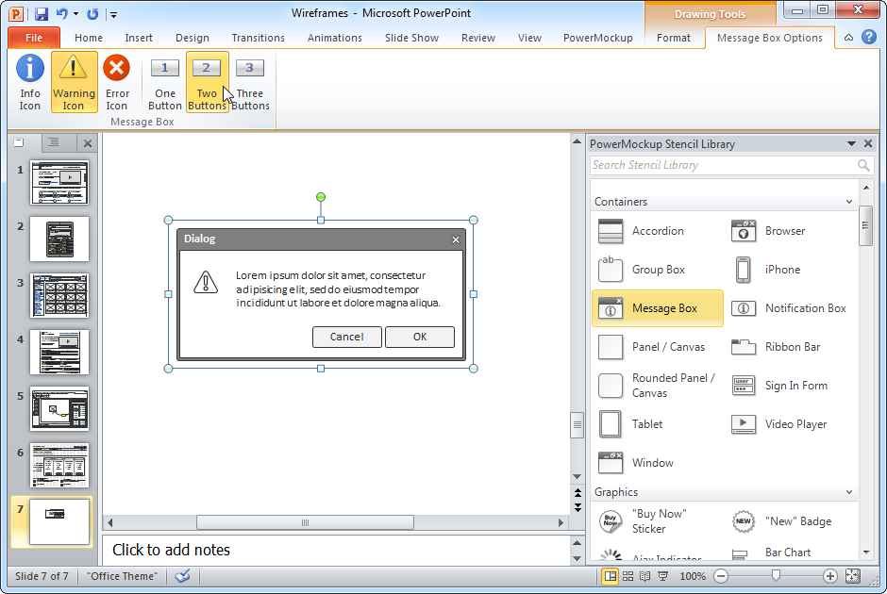
Get more out of PowerPoint with PowerMockup!
Library of over 250 wireframe shapes and icons
Easy to use via drag and drop
“Instant search” feature
Ability to add custom shapes and categories
Import and export functions for sharing custom shapes with others
Works with PowerPoint 2007, 2010, and 2013
Give it a try: http://www.powermockup.com/
Created for: http://www.onextrapixel.com

Slide 40
License
This work is licensed under a Creative Commons Attribution-ShareAlike 3.0 Unported License.
Please link back to http://www.powermockup.com/ when used.
Attribution:
Icons: Based on the “Font Awesome” font by Dave Gandy, http://fortawesome.github.com/Font-Awesome

